Slide 1
Conditional Rendering
If-else statement | Ternary operator | Logical && Operator
Notes:
Welcome to our lecture on conditional rendering in react. In this lecture we will go through if-else statement, ternary operator, and logical and operators. Let’s start the video lecture.

Slide 2

If-else Statements
Conditional rendering allows a component to display different content based on state.
An if-else statement can be used to determine what to render.
Example: Show a welcome message for a logged-in user and a different message for a guest.
Notes:
Now, let’s talk about if-else statements in React. Conditional rendering allows components to display different content based on state. Using an if-else statement, we can determine what to render depending on conditions. For example, a component can show a welcome message for a logged-in user and a different message for a guest, making the UI dynamic and responsive.

Slide 3
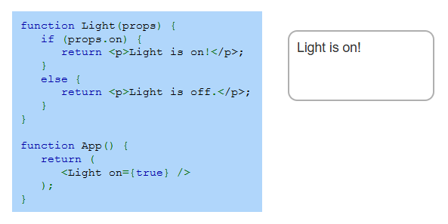
Example
Notes:
Let’s examine this example of conditional rendering. The Light component uses an if-else statement to check the on prop. If on is true, it displays Light is on. Otherwise, it shows Light is off. In the App component, Light is rendered with on set to true, so the message Light is on appears. This approach allows components to display different content dynamically based on props.

Slide 4
Ternary Operator
The ternary operator (? :) is a shorthand for conditional rendering in React.
It returns one expression if the condition is true and another if false.
Example: {props.on ? "Light is On" : "Light is Off"} displays different messages based on props.on.
Notes:
Now, let’s discuss the ternary operator in React. The ternary operator provides a shorthand way to handle conditional rendering. It returns one expression if the condition is true and another if false. For example, instead of using if-else statements, we can check if a light is on by saying if props dot on is true, display Light is On, otherwise, display Light is Off, making the code more concise.

Slide 5
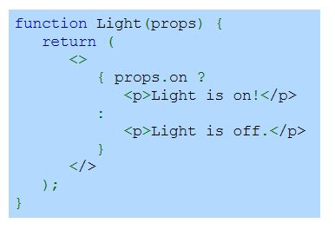
Example
Notes:
Let’s take a look at this example using the ternary operator. The Light component checks the on prop and uses a ternary expression to determine what to display. If props dot on is true, it returns the message Light is on. Otherwise, it returns Light is off. This approach simplifies conditional rendering, making the code more readable and efficient without needing a full if-else statement.

Slide 6
Object in State
The logical && operator conditionally renders JSX when the left-side expression is true.
If the condition is false, nothing is rendered.
Example: {isLoggedIn && <p>Welcome back!</p>} shows the message only if isLoggedIn is true.
Notes:
Now, let’s explore conditional rendering using the logical AND operator. In React, this operator renders JSX only when the left-side condition is true. If the condition is false, nothing is displayed. For example, if is Logged In is true, the message "Welcome back" appears. Otherwise, nothing is shown. This approach keeps the code clean by avoiding explicit if-else statements.

Slide 7
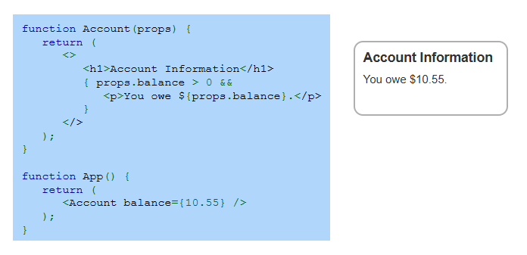
Example
Notes:
Let’s take a look at this example of using the logical AND operator. The Account component checks if the balance is greater than zero. If true, it displays a message showing the amount owed. Otherwise, nothing is rendered. In the App component, the balance is set to 10.55, so the message appears. This method keeps the code simple by conditionally displaying content without using if-else statements.

